Slide 1
A Fast and Low-Overhead Technique to Secure Programs Against Integer Overflows
Raphael Ernani Rodrigues, Victor Hugo Sperle Campos, Fernando Magno Quintao Pereira
Department of Computer Science – The Federal University of Minas Gerais (UFMG) – Brazil
CGO ’13 23-27 February 2013, Shenzhen China

Slide 2
Introduction
There are plethora work to track Integer overflows.
Ada, Lisp:
Can be customized to throw exceptions whenever integer overflows are detected
C,C++:detect the occurrence of overflows dynamically.
Take some action when an overflow happens.
To do this, arithmetic operations need to be surveilled, and the runtime checks cost time.
Zhang et al. [28] have eliminated some of this overhead via a tainted flow analysis.
This paper :
With Analysis algorithm to eliminate Overflow.

Slide 3
Contribution
A framework to detect overflow.
Arithmetic operations need to be surveilled.
With Range Analysis to speed up the framework
( statically detect overflow).

Slide 4
Range Analysis

Slide 5
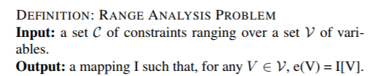
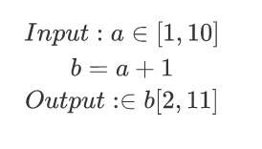
Range Analysis
Definition
E.g. V = {a, b} ; C = { b = a + 1}

Slide 6
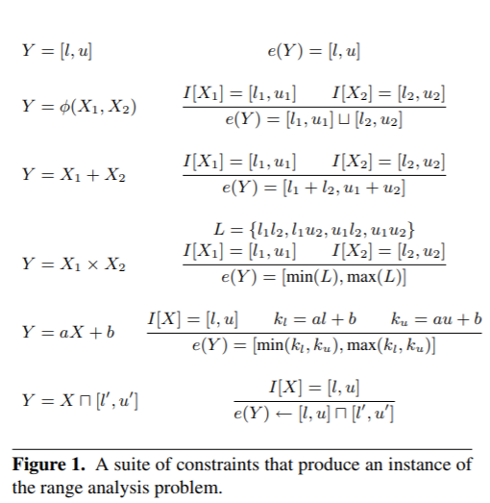
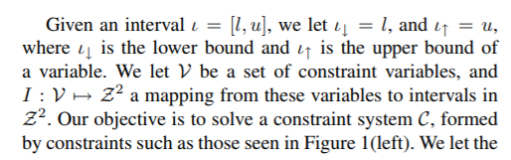

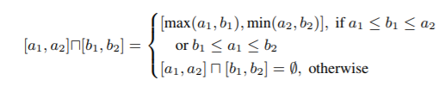

Several notations
Notes:
我们的目标是给定X1，X2的取值范围，尽可能精确的求Y的取值范围。
约定两个运算公式：如左边。可以理解成一个是交，一个是并。

Slide 7
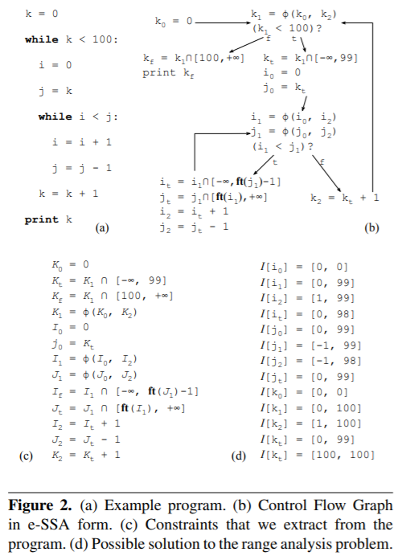
Range propagation
1） Convert the program to e-SSA graph.
Notes:
第一步是将程序从原来的形式，转到e-SSA形式。
基本和SSA形式一样。什么是e-SSA形式呢？

Slide 8
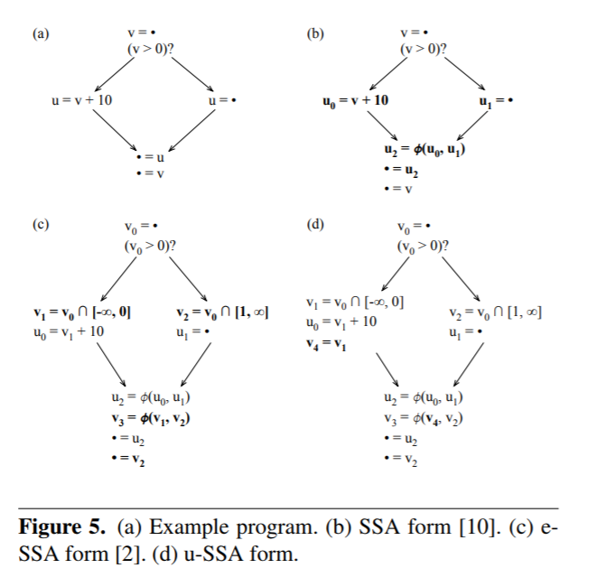
e-SSA Form – about branch
E-SSA and U-SSA
Notes:
第一张图是一个简单的样例程序。
第二张图是SSA 形式。
e-SSA form ：
和声明的不同在于，在遇到分支的时候，会将分支条件的变量加上范围加入到分支中。

Slide 9
Range propagation
1） Convert the program to e-SSA graph.
2） Extract constraints.
Notes:
第二步：从程序中提取所有的约束。

Slide 10
Range propagation
1） Convert the program to e-SSA graph.
2） Extract constraints.
3） Build a constraint graph.
Notes:
第二步：从程序中提取变量和约束。

Slide 11
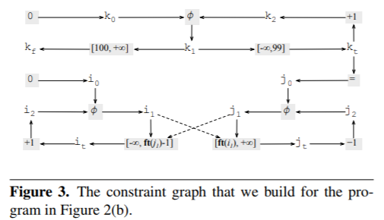
Notes:
希望构建这样一个依赖图。
∩可以理解为条件

Slide 12
Range propagation
1） Convert the program to e-SSA graph.
2） Extract constraints.
3） Build a constraint graph.
4） Find the strongly connected components
5） Apply a three-phase approach to solve the value range.
Notes:
解释一下strongly connected components，就是指有关系的节点。

Slide 13
Range propagation
1） Convert the program to e-SSA graph.
2） Extract constraints.
3） Build a constraint graph.
4） Find the strongly connected components
5） Apply a three-phase approach to solve the value range.
Notes:
这是Range Analysis 的过程。
第一步：将程序表示成sparse analysis的形式。
第二步：从程序中提取变量和约束。
第三步：构建一个constraint graph
第四步：寻找变量的计算关系
第五步：三步法—求解变量之间有约束关系
目标是找到像这样的范围

Slide 14
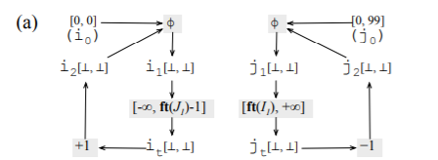
Three-phase approach
① Windening ② Future resolution ③ Narrowing

Slide 15
Windening
We start solving constraints by determining how each program variable might grow.
For instance,
If a variable is only updated by sums with positive numbers, then it only grows up.
If a variable is only updated by sums with negative numbers, then it only grows down.
Some variables can also grow in both directions

Slide 16
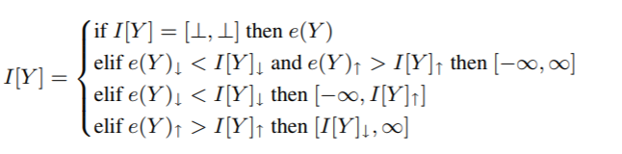
We let [l, u]↓ = l and [l, u]↑ = u. We let ⊥ denote noninitialized intervals, so that [⊥, ⊥] U[l, u] = [l, u]. This operation only happens at φ-nodes,

Slide 17
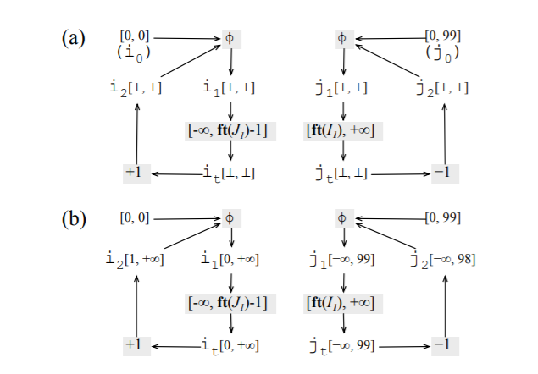

Slide 18

公式
Linear Time
E(i1)=[0,0]∪[1,1]
i1[0,∞]
E(i1)=[0,0]∪[1,1]
=[0,1]
i2[1,1]
i1[0,0]
i1[1,∞]
it[0,0]
i1[0,∞]
i1 = [0,0] e(i1) = [0, 1]
推出 i1=[0,∞]
Notes:
可以看出只增长了。

Slide 20
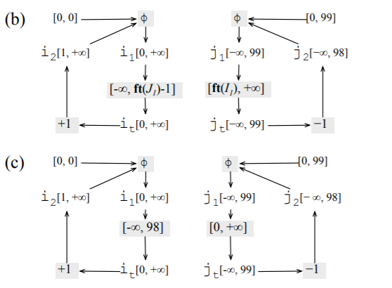
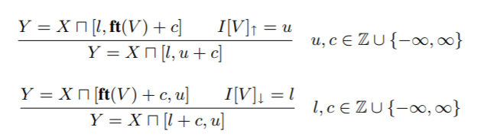
Future Resolution

Slide 21
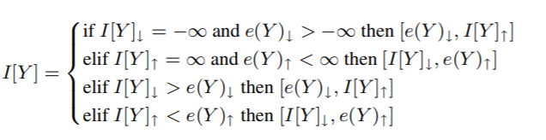
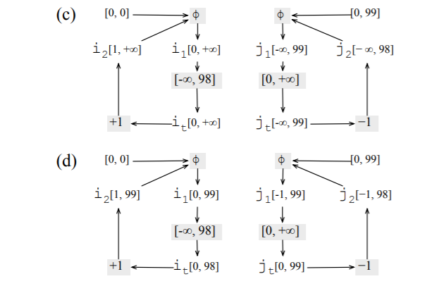
Narrowing
Notes:
从无穷收敛

Slide 22
Narrowing
E(i1) = [0,99]
i2[1,99]
i1[0,99]
E(i2) = [1,99]
i1[0,98]
Notes:
从无穷收敛

Slide 23
Narrowing
Notes:
从无穷收敛

Slide 24
A framework to detect overflow

Slide 25
Dynamic Instrumentation Library
1. Identifying the instructions that may lead to an overflow
Arithmetic operations need to be surveilled, and the runtime checks cost time.
Inserting assertions after those instructions.
Key point:
Traditional overflow detections find overflow after it happens.
But this one find before it happens.

Slide 26
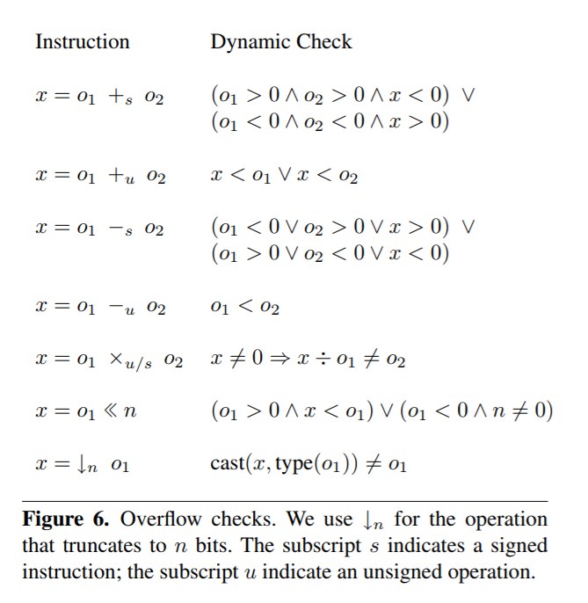
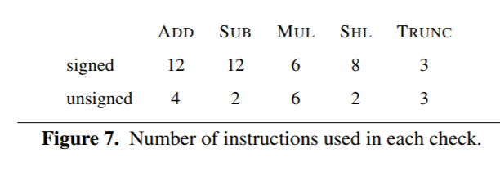
How to identify?
6 basic operations

Slide 27
Actions
First option: no-op.
This option allows us to verify the slowdown produced by the new instructions.
Second option: logging.
Standard
Third option: abort.
This option terminates the program once an overflow is detected.
Thus, it disallows undefined behavior due to integer over- flows, and gives us the opportunity to use the u-SSA form to get extra precision.

Slide 28
e-SSA Form – about branch
E-SSA and U-SSA
Notes:
第一张图是一个简单的样例程序。
第二张图是SSA 形式。
e-SSA form ：
和声明的不同在于，在遇到分支的时候，会将分支条件的变量加上范围加入到分支中。

Slide 29
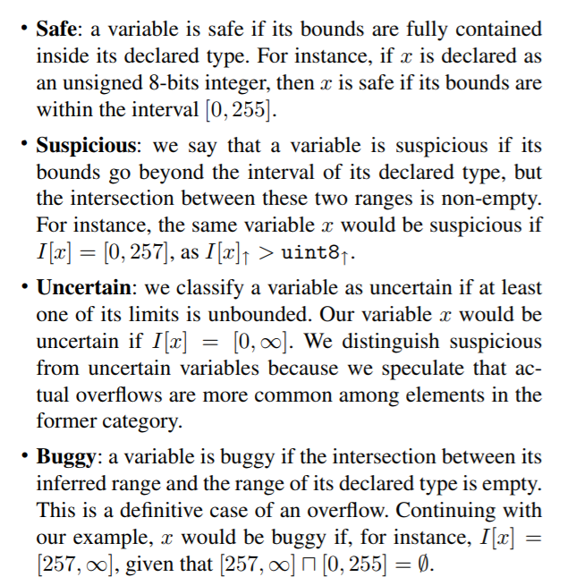
Use static analysis to avoid some checks
Our static analysis classifies variables into four categories, depending on their bounds

Slide 30
Avoid 15% of all overflow checks.
Reduce runtime by 50%.

